Slide 1
BITCOIN SCRIPT PART 2

Slide 2

Bitcoin Scripts
Simple, compact, stack-based and processed left to right
FORTH like language
Not Turing Complete (no loops)
Halting problem is not there

Slide 3


Bitcoin Scripts – A Simple Example
^{T}(A->B)
scriptSig ,scriptPubKey
Bob can spend the bitcoins only if both the scripts return true after execution

Slide 4
Bitcoin Scripts
18E14A7B6A30… D61967F63C7DD…
Transaction
Input
scriptSig:
OP_DUP OP_HASH160
16UwLL9Risc3QfPqBUvKof… OP_EQUALVERIFY OP_CHECKSIG
Transaction
Output
scriptPubKey:

Slide 5
Bitcoin Scripts
scriptPubKey: OP_DUP OP_HASH160 <pubKeyHash> OP_EQUALVERIFY OP_CHECKSIG
scriptSig: <sig> <pubKey>
The stack is initially empty. Both the scripts are combined – input followed by output
<sig> <pubKey> OP_DUP OP_HASH160 <pubKeyHash> OP_EQUALVERIFY OP_CHECKSIG

Slide 6
Bitcoin Scripts
<sig> <pubKey> OP_DUP OP_HASH160 <pubKeyHash> OP_EQUALVERIFY OP_CHECKSIG
<pubKey>
<sig>
The stack is initially empty. Both the scripts are combined
OP_DUP OP_HASH160 <pubKeyHash> OP_EQUALVERIFY OP_CHECKSIG

Slide 7
Bitcoin Scripts
OP_DUP OP_HASH160 <pubKeyHash> OP_EQUALVERIFY OP_CHECKSIG
<pubKey>
<pubKey>
<sig>
Top stack item is duplicated
OP_HASH160 <pubKeyHash> OP_EQUALVERIFY OP_CHECKSIG

Slide 8
Bitcoin Scripts
<pubHash>
<pubKey>
<sig>
OP_HASH160 <pubKeyHash> OP_EQUALVERIFY OP_CHECKSIG
Top stack item is hashed (RIPEMD-160 hashing)
<pubKeyHash> OP_EQUALVERIFY OP_CHECKSIG

Slide 9
Bitcoin Scripts
<pubKeyHash>
<pubHash>
<pubKey>
<sig>
<pubKeyHash> OP_EQUALVERIFY OP_CHECKSIG
The constant is pushed in the stack
OP_EQUALVERIFY OP_CHECKSIG

Slide 10
Bitcoin Scripts
<pubKeyHash>
<pubHash>
<pubKey>
<sig>
OP_EQUALVERIFY OP_CHECKSIG
Equality is checked between the top two items in the stack
OP_CHECKSIG

Slide 11
Bitcoin Scripts
<pubKey>
<sig>
OP_CHECKSIG
Signature is checked based on the top two stack item
TRUE

Slide 12
Interesting Bitcoin Scripts
Provably un-spendable or prunable outputs
scriptPubKey: OP_RETURN {zero or more ops}
Anyone-can-spend outputs
scriptPubKey: {empty}
scriptSig: OP_TRUE

Slide 13
Interesting Bitcoin Scripts
Freezing funds until a time in the future
scriptPubKey: <expiry_time> OP_CHECKLOCKTIMEVERIFY OP_DROP OP_DUP OP_HASH160 <pubKeyHash> OP_EQUALVERIFY OP_CHECKSIG
scriptSig: <sig> <pubKey>

Slide 14
Bitcoin P2P Network

Slide 15
Bitcoin P2P Network
An ad-hoc network with random topology, Bitcoin protocol runs on TCP port 8333
All nodes (users) in the bitcoin network are treated equally
New nodes can join any time, non-responding nodes are removed after 3 hours

Slide 16
Joining in a Bitcoin P2P Network

Slide 17
Joining in a Bitcoin P2P Network

Slide 18
Joining in a Bitcoin P2P Network
Seed Node
Give me the address

Slide 19
Joining in a Bitcoin P2P Network
Seed Node
<address list>

Slide 20
Joining in a Bitcoin P2P Network
Seed Node

Slide 21
Joining in a Bitcoin P2P Network
Get most recent blockchain

Slide 22
Joining in a Bitcoin P2P Network
Start transaction

Slide 23
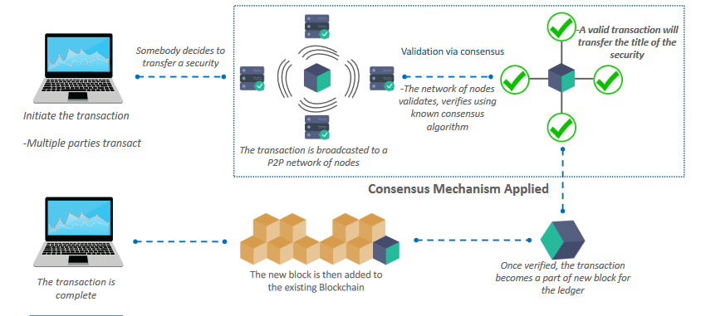
Overview

